Slide 1
Korea’s e-Procurement
& Tools for Data Sharing
Minsook Hong |
Public Procurement Service (PPS)
mshong15@korea.kr

Slide 2
e-Procurement in Korea
Ⅰ

Slide 3
Coverage & Cost of PPS
PPS’s
Coverage
PPS (30%)
Total Government procurement was USD 119 billion $
PPS procurement share was 30% (36.5 B $ USD)
50,366 Public Entities, 320,983 Registered Suppliers
Korea’s PP
Total $119 billion
Use of PPS’s procurement services :
All public entities should purchase from PPS’s MAS contracts* whenever applicable
Central govt. | Mandatory*
Local govt. & public enterprises | Optional
* threshold - $100,000 for goods and services, $3,000,000 for construction
PPS’s Services
Fee
Generated through the fees charged by PPS for contracts made on behalf of public organizations
- PPS labor costs, contract-related expenses
- Revolving fund that is used to expedite payment to suppliers
- Support for SMEs
* MAS contract : unit-price framework contracts for commercially available products.
All public entities may place orders for MAS contracted products.

Slide 4
Public Procurement in Korea
Transaction via KONEPS : USD 74.5 B (60%) of Korea’s public procurement
However, 100% of tender notices are published through KONEPS
PR (mandatory)
Central Government
30%
Local
Government
& Public
Enterprises
PR (optional)
30%
Decentralized Procurement
Specialized
Entities
(21 Utility Electric, Gas)
40%

Slide 5
E-Procurement (KONEPS)
KONEPS (Korea On-line E-Procurement System)
Single window for public procurement
End-to-end service that covers the entire procurement processes
Seamless service through data interconnection with 187 database systems
“KONEPS”
Korea
ON-line
E-Procurement
System
e-Bidding
e-Contracting
e-Payment
Tender Notice
Price Assessment
Evaluation / Analysis
Contract Registration
Composition and Sealing
of Contracts
Contract Review
Online
Shopping
Mall
e-Ordering
E-payment
Expenditure Management
Fee management
Product Registration
E-catalogue
Product Search
Online Order

Slide 6
E-Transformation-Before & After
Seamless Service through Data Integration
Data interchange with 187 external info systems for seamless process
Before
Ministry of Strategy
and Finance
Public Buyer
Industry
Associations
Bid
Supplier
National Tax Office
Surety Companies
Construction
Authorities
Credit Rating Companies
Certification-
Related agencies

Slide 7
E-Transformation-Before & After
Seamless Service through Data Integration
Data interchange with 187 external info systems for seamless process
After
Contract
Delivery
Ministry of Strategy
and Finance
Industry
Associations
Public Buyer
National
Tax Office
KONEPS
Credit Rating
Company
Construction
Authorities
Surety
Companies
e-Bid
Korea Financial
Telecommunications
& Clearings Institute
Certification-
Related agencies
Supplier

Slide 8
KONEPS Online Shopping Mall
e-Ordering through KONEPS Online Shopping Mall
Framework Contracts (unit-price based) for frequently purchased commercial products
Contracted by PPS, available for all public entities for e-ordering

Slide 9
KONEPS Online Shopping Mall

Slide 10
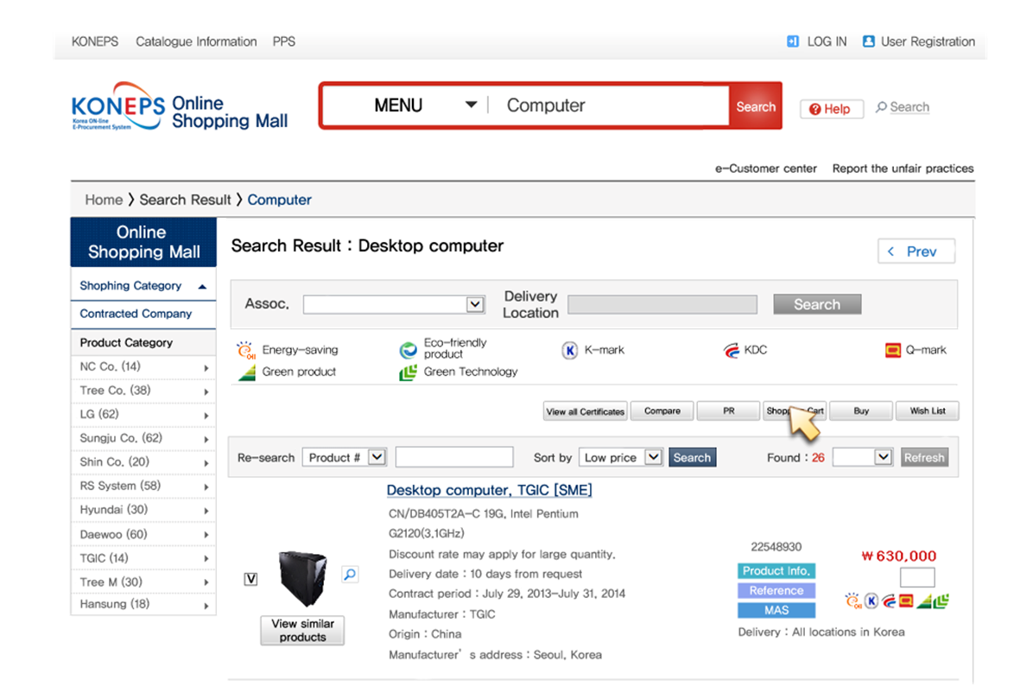
KONEPS Online Shopping Mall

Slide 11
Improvement of KONEPS
Launch KONEPS (After KONEPS)
2002
Launch KONEPS
2004
Personalized Service based on CRM
2006
Integrated Shopping mall
2008
On-Line proposal assessment system
2010
e-tendering by fingerprint
2011
Digital procurement enabled via Smartphone
2015
KONEPS open to private sector

Slide 12
Success factors of KONEPS
e-Procurement as Part of Broader e-Government Project
e-Government
Innovation in Services
Administrative Productivity
1
Government-wide e-Procurement System
5
National Finance system
Integrated Administration System for Local Governments
2
Single Window for Civil Services
6
7
Nation-wide Educational Administration System
3
Integrated Social Security Information System
8
Standardized HR Management System
4
Internet-based National Taxation System
9
Consolidation of e-Document Exchange and e-Reporting
INFRASTRUCTURE
10
e-Authentication and e-Signature System
11
Government-wide IT-governance Environment

Slide 13
Success factors of KONEPS
Carrot and Stick
The Carrot
Use of e-Contracting
Discount for service fees when procurement request is made via KONEPS
98%
Sending letters to heads of public entities when procurement requests arrive in paper or fax
Marketing visits to public entities
40%
The Stick
20%
Use of KONEPS was included in the government-wide performance evaluation criteria until 2009
2002
2006
2010

Slide 14
Success factors of KONEPS
Training and User Support
Nation-wide Training Sessions
Classroom training sessions for both public officials and suppliers at Public Procurement Training Institute and 13 Regional PPS offices
In the early onset of e-Bidding, PPS held 130 training sessions in one year and operated training courses at 23 locations across the nation
Online Simulation Module
Step-by-step user simulation module available within KONEPS
Web Call Center
55 staff offering 4,585 consultations daily via phone and web video conferencing

Slide 15
Korea’s Data Sharing Policies
Ⅰ
Information Disclosure via KONEPS
Statistical System for Public Procurement
Open API on Public Procurement

Slide 16
Information Disclosure via KONEPS
Available Data
Entire Process from PR to contract disclosed to public
Quotation Request Status
Quotations, price requests are made to PPS by public entities and request status is revealed
Procurement Request Status
Status of procurement request entrusted to PPS is revealed
Bid result provided (Name of bidders, rank, bid price)
Bid Results
Procurement Plan revealed by public entities prior to bid notice
Procurement Plan
Preliminary Tender Notice
Tender Notice
Contract Status
Contract data provided (supplier, price, contract no., period of contract)
Specifications open prior to bid notice
Bid data on KONEPS and other e-procurement systems provided

Slide 17
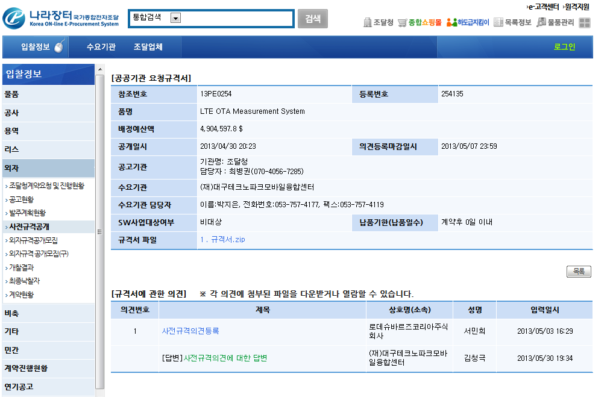
Information Disclosure via KONEPS
Pre-tender Phase : Advance Notice of Tender Specifications
Challenge Deadline
Contracting Official’s contact
Preliminary Tender Notice
Challenge from a Firm
Response from Contracting Officer

Slide 18
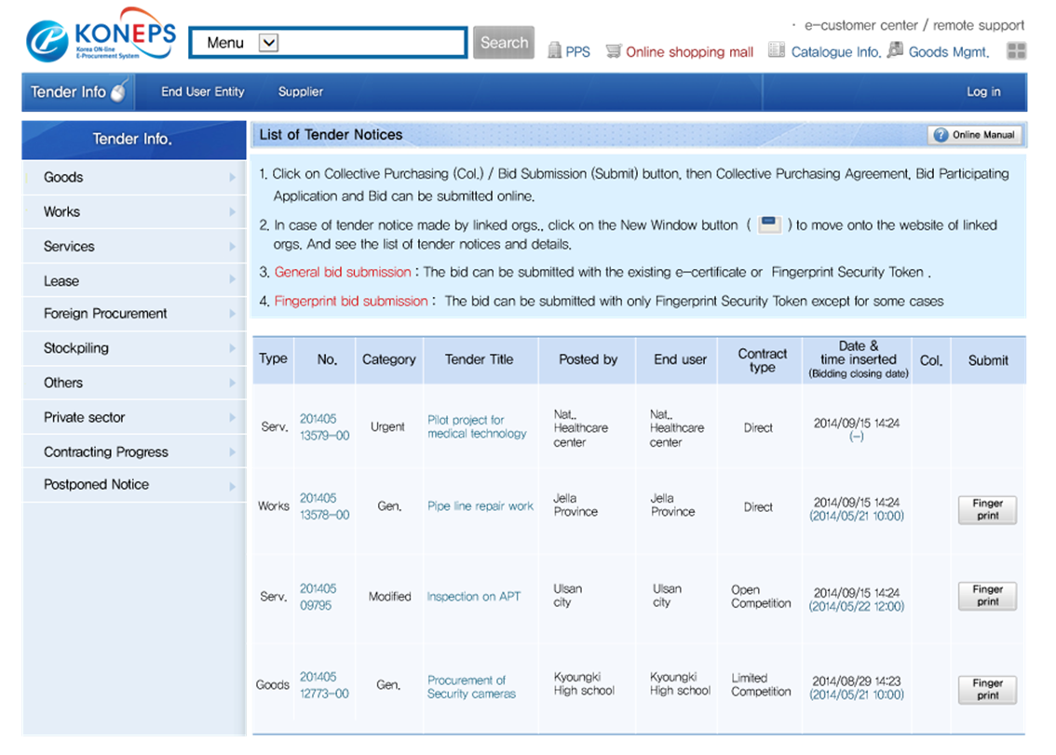
Information Disclosure via KONEPS
List of Tender Notices
No Need To Login

Slide 19
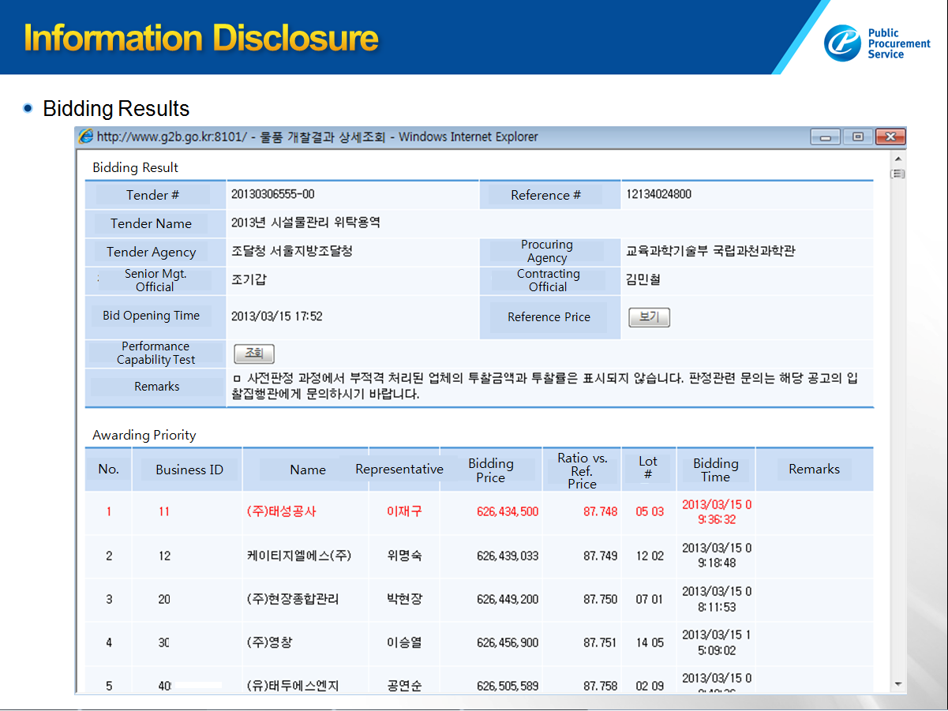
Information Disclosure via KONEPS
Bidding Results

Slide 20
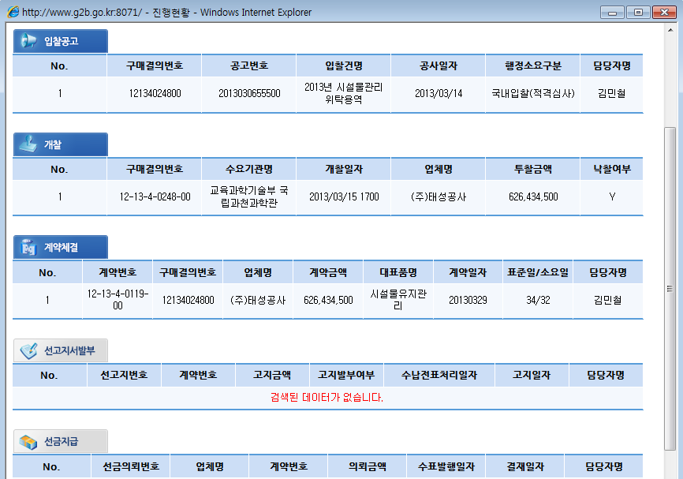
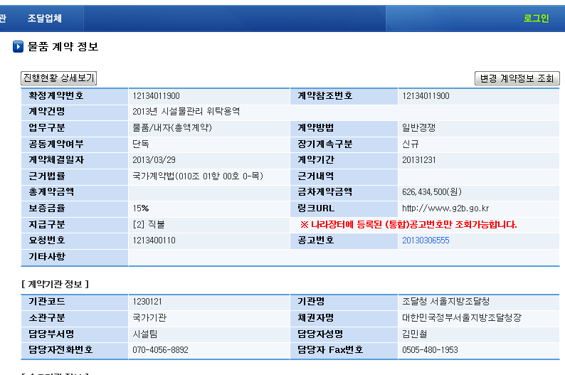
Information Disclosure via KONEPS
Contract Details
Tender Notice
Full Progress Report
Contract Info
Contract Modification Report
Purchase #
Tender #
Tender Name
Date
Compt. Type
Contr.
Official
Contract #
Reference #
Awarding
Contract Name
Purchase #
Procuring Entity
Bid Opening
Nominee
Price
Award
Category
Competition Method
Single / Consortium
Single / Extended
Contract Date
Contract Period
Governing Law
Contracting
Contr. Price
Total Contr. Price
Contr. #
Purchase #
Contractor
Price
Item
Date
Process time (days)
Standard / Actual
Contr. Official
Performance Bond
URL
Payment Method
PR #
Tender #
Remarks
Upfront Payment Request
Contracting Agency Info
Agency Code
Agency Name
Agency Type
Representative
Contracting Unit
Contracting Officer
Upfront Payment
Contact
Fax

Slide 21
Statistical System for Public Procurement
Open Data Policy
‘All(Ontong) Procurement ’ Website ppstat.g2b.go.kr
- Interfacing 24 public procurement systems’ DB + paper-based contracting
- Provide integrated procurement data (102 types of report format)
Contracts for goods, services and construction
102 statistics reports on contract data
collected and analyzed
Public Entities
Statistic system
e-contracts
(95.8%)
Bidding& contract data
102 Statistics
24 e-Procurement systems
Data collection and analysis
Central gov.
Schools
(data collection via linkage)
Paper-based contracts
(4.2%)
Statistical
DB
Local gov.
Public hospitals
Contract data
(entities entering contract info.)
Police office
Firehouse
Paper-based contracts

Slide 22
Statistical System for Public Procurement
102 Types of statistical data
Category |  | Contents | Quantity
Major Statistics |  | Overall status of entire public procurement, procurement data by entity, by supplier, by contract type, data of limited contract by region, compulsory joint contract, contract by contract purpose | 7
General Statistics (90) | Entities | Statistics on public entities | 13
 | Suppliers | Statistics on suppliers | 8
 | Regions | Statistics on regions of end users or suppliers | 9
 | Contract type | Statistics by contract type (goods, construction, service, technical service) | 41
 | Support Policies | Statistics on support for SMEs, social enterprises, green products | 19
Customized Statistics |  | Customized statistics for an individual entity | 5
Total |  |  | 102

Slide 23
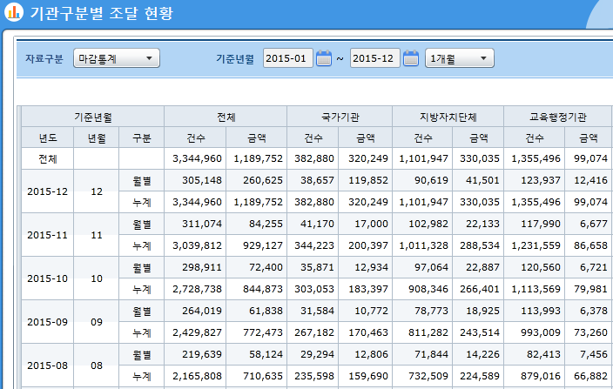
Statistical System for Public Procurement
Example of statistical report (table type)
Name of Statistics
Period
Entity
Year/Date
No./Price
Month/Total

Slide 24
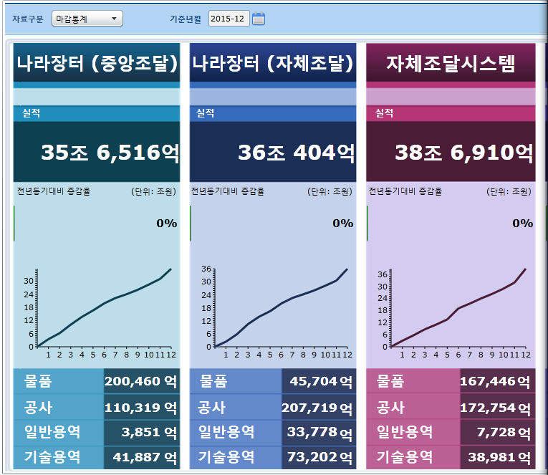
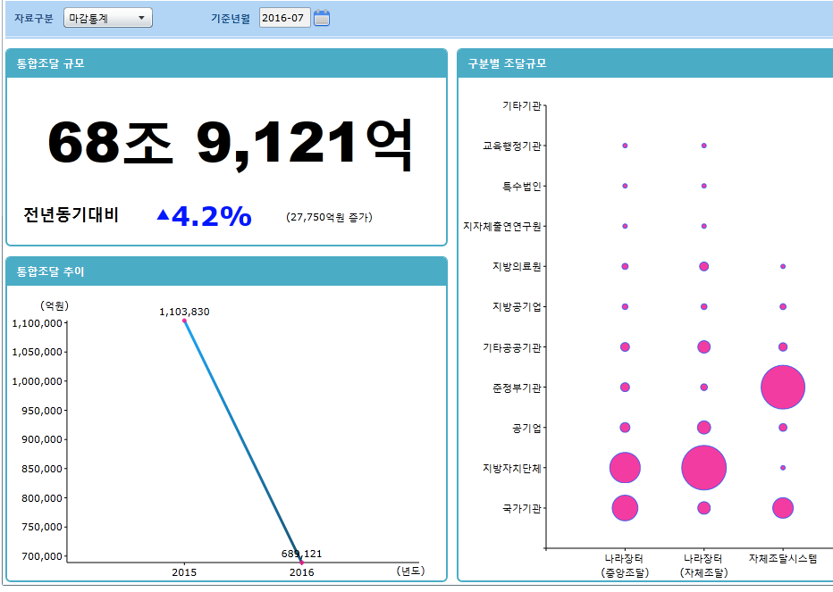
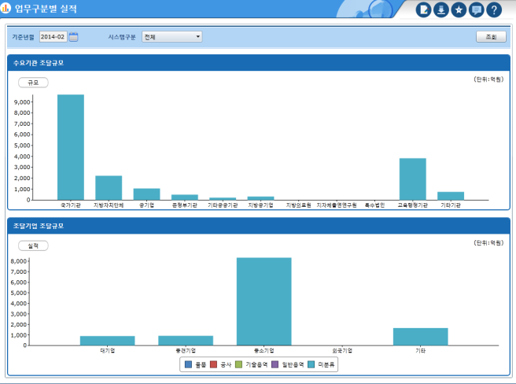
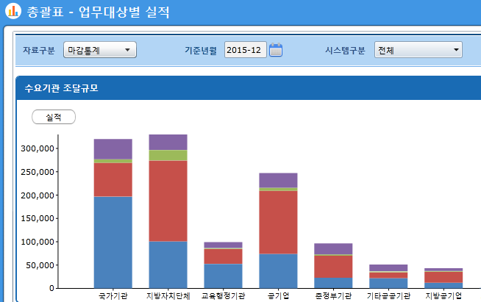
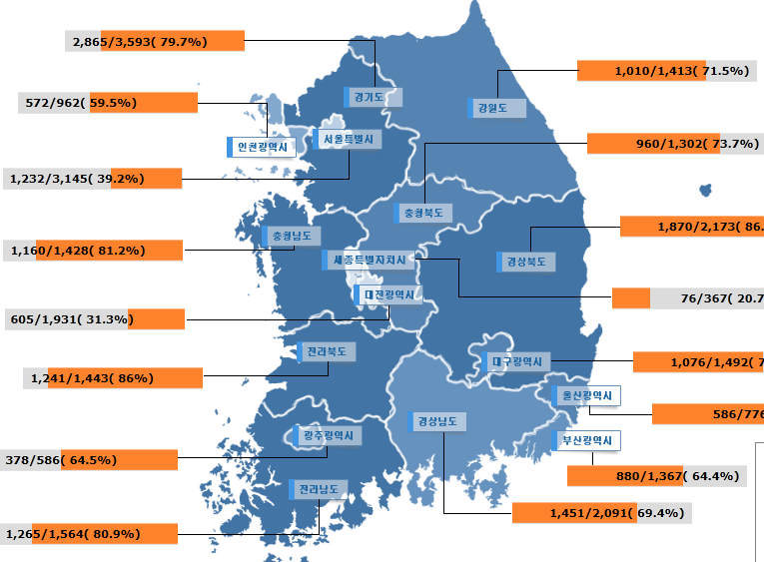
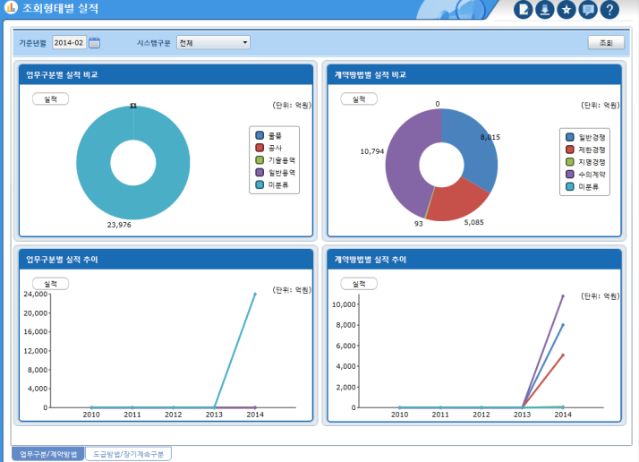
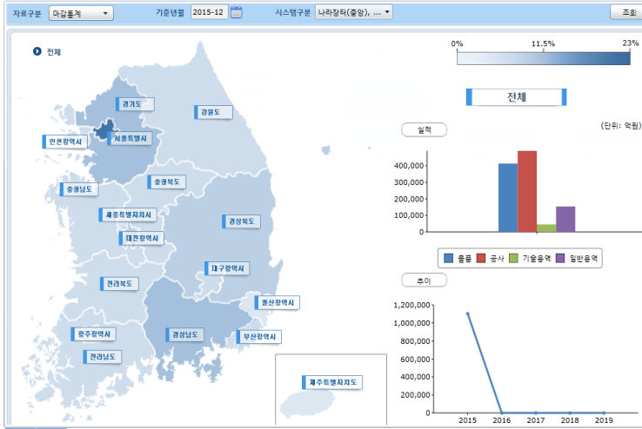
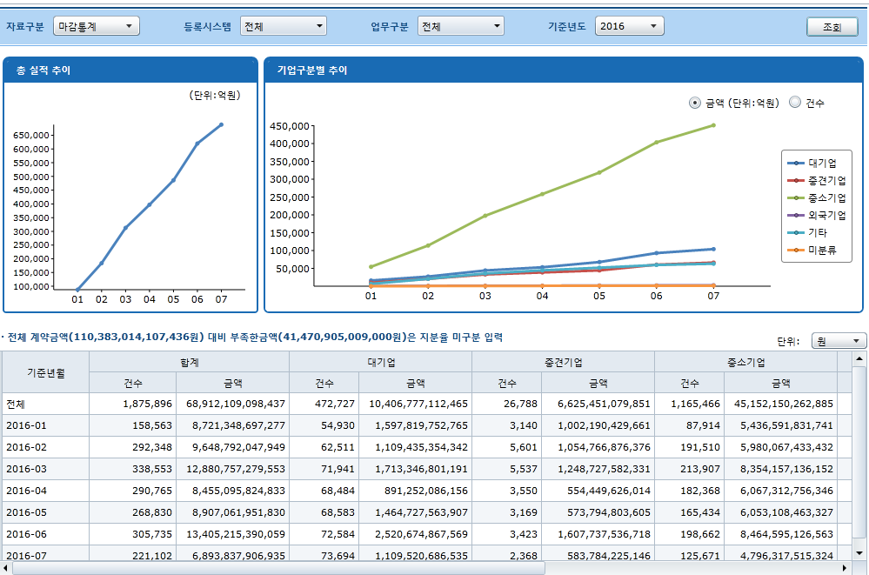
Statistical System for Public Procurement
Example of statistical report (bar-graph, map type)
By service category
By regional share

Slide 25
Effects of Statistical System
Effective Policy
Making/Execution/
Evaluation
Strategy Building and
Market Analysis
Procurement policy making based on data
Market entrance plans via monitoring market trends
Suppliers
Real-time check of effects of policies
Public Entities
Evaluation on results of policy execution
People
Enhancement of Transparency
Easy access to info. on budget execution regarding procurement

Slide 26
Open API on Procurement Data
Additional value creation using procurement info
Open API(Open Application Programming Interface)
- Interface where programmers freely develop app. or web service based on data rendered
by data providers(approx. 2,000 data registered)
< Flow of Public Data Utilization via Open API >
Search for public data needed for app./web service
Open API provision
App./web service
Public Entities
Private Developer
Public
Based on public data

Slide 27
Open API on Procurement Data
Example of utilizing procurement data
Customized tender notice information
Service of providing tender info.
Tender notice data
Service provision
Service development
website
Mobile phone Apps.
Service fee
More diverse and convenient
searching functions than KONEPS
Procurement firms
$ 20~30
(monthly)
Procurement data developer
70~80 related services are commercialized

Slide 28
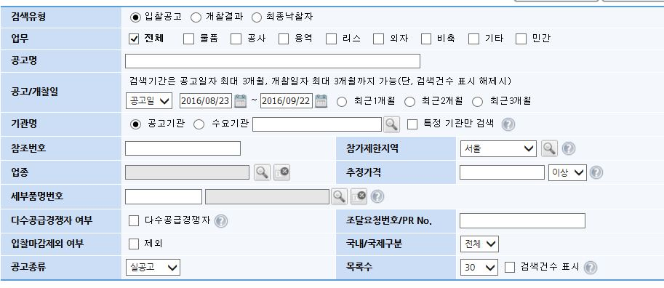
Open API on Procurement Data
Example of utilizing procurement data
KONEPS vs. Open API customized service
Participation region
Supplier Category
Price Range
Item Classification #
- Searching criteria for tender notice is not diverse
- Multiple searching is not available (single criteria at a time)
- Alarm service for interested tender notices via text, e-mail not available

Slide 29
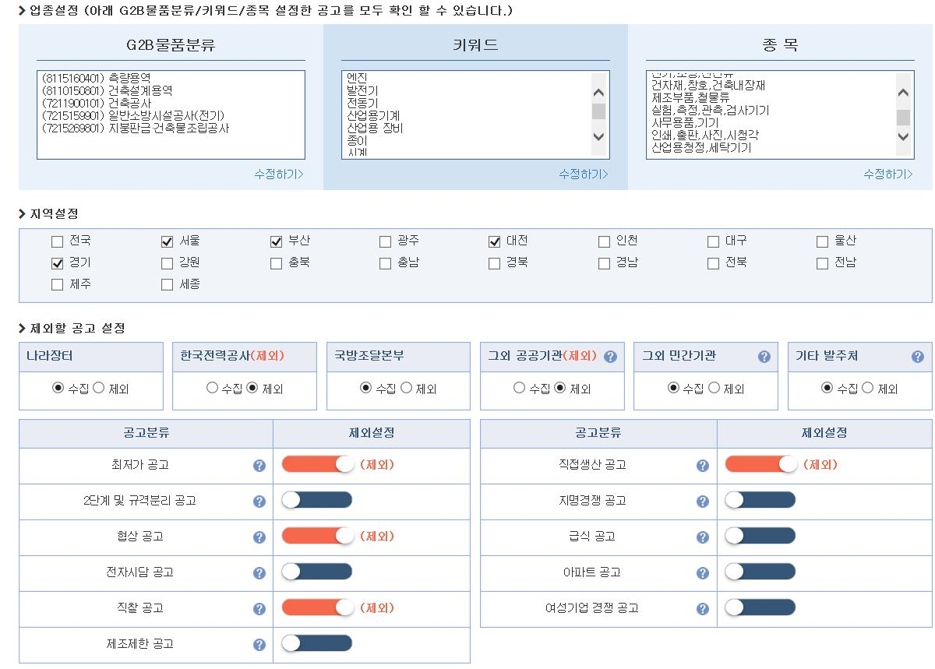
Open API on Procurement Data
Example of utilizing procurement data
KONEPS vs. Open API customized service
Source: Info 21C(Donggin Company)
Search by various criteria like product sorting No., keyword, industries
Search by region
Search by end-user
Search by selection method, contract method

Slide 30
Open API on Procurement Data
Example of utilizing procurement data
Bid Awarding Analysis Service
Bid Consulting
Awarded bids are analyzed in table, graph, calculation program
Training & awarding service to firms with lack of knowledge to be successful
Data of bid awarding
< Description>
Search for bid progress and outcome analysis
Bid awarding record by end-users and statistics analysis
Analysis of participating bidders
< Description>
Procedure of e-
bidding, terminology,
online bid training
Price prediction and recommendation through analysis of awarded firms by the end-user
Contract Data

Slide 31
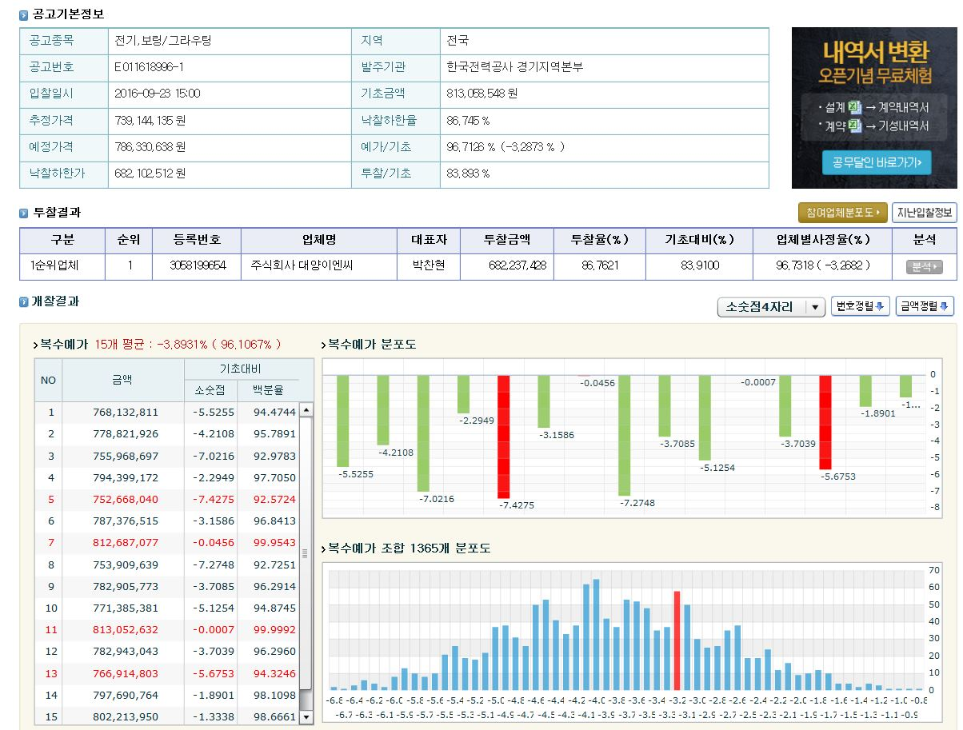
Open API on Procurement Data
Example of utilizing procurement data
<Bid awarding data analysis service>
Source: Info 21C(Donggin Company)
Basic bid Data
(Standard price, unsuccessful rate, reference price)
Outcomes
(winning bidder)
Outcome analysis
(multiple reference prices, distribution chart to standard price)

Slide 32
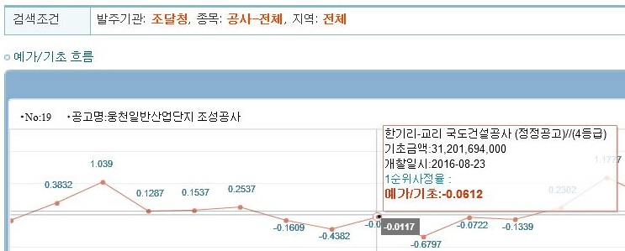
Open API on Procurement Data
Example of utilizing procurement data
<Bid awarding data analysis service>
Source: Info 21C(Donggin Company)
Data on bid participating firms(by firm bid price, lowest tender rate)
End-user analysis
(proportion calculation with reference and standard prices)

Slide 33
Open API on Procurement Data
Value creation using procurement info
<Procurement Data Market>
80 entities
USD 50 ~60 million
800~1000 personnel
No. of firms using procurement data
Size of Procurement data market
Job Creation

Slide 34
Notes:
감사합니다.

